Slide 1

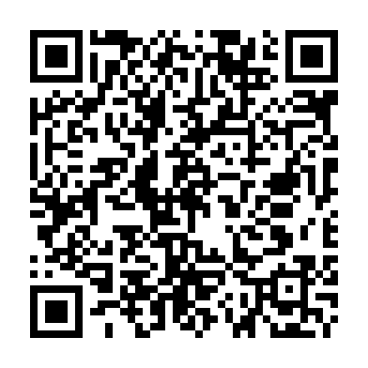

An idea of Leonardo Chistè, Rayan Alessandro Tekaia, Alberto Battistini and Saksham Bakshi
Want to see the full project? Visit the following website or scan the QR Code!
https://github.com/PossumLiarR/Smart-Surveillance

Slide 2
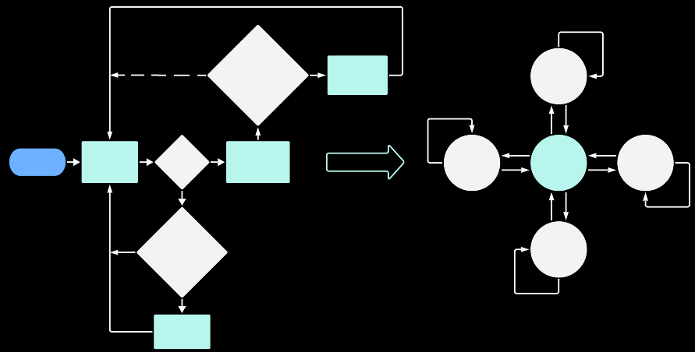
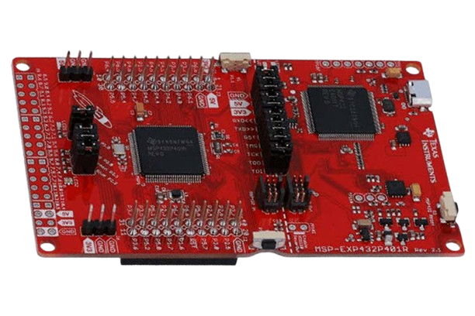
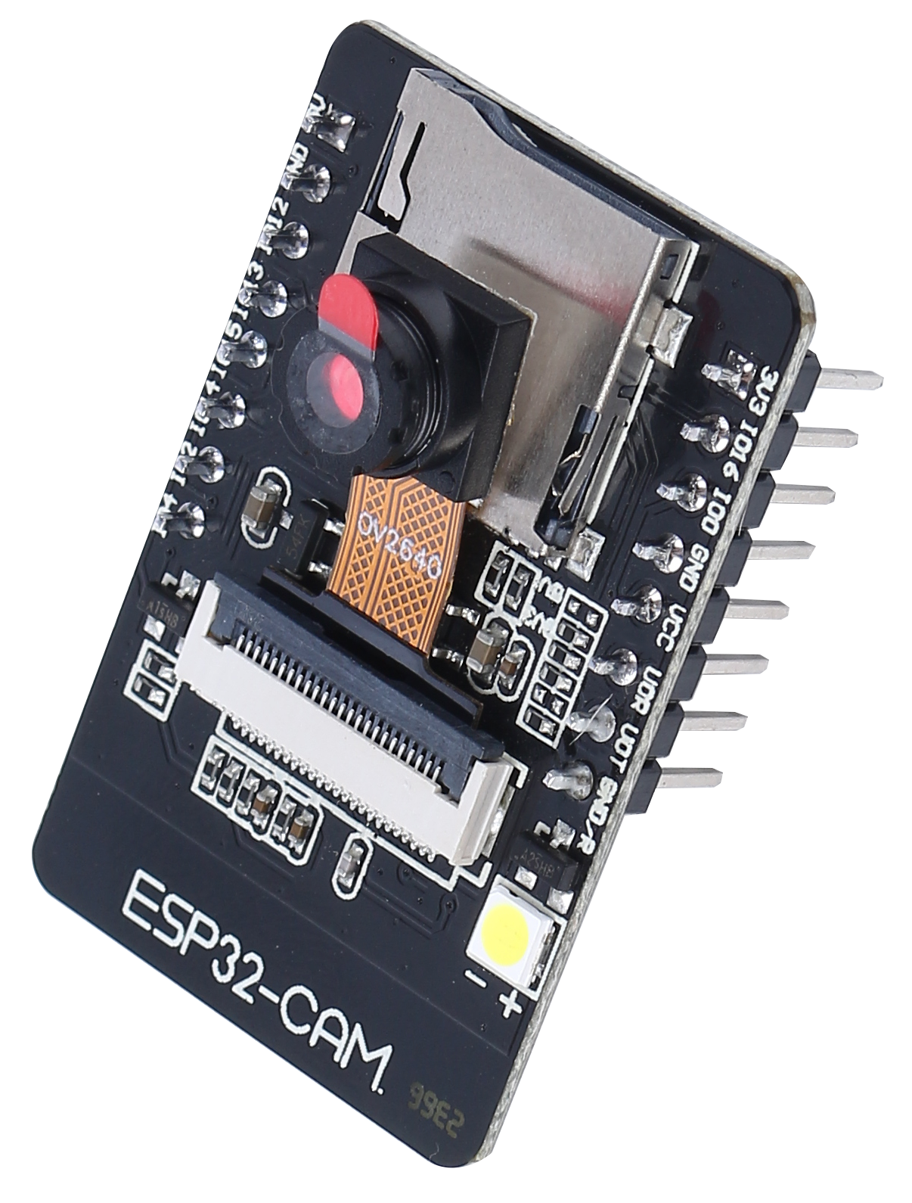


Smart Surveillance: Software Architecture
No
image_counter_to_send >= SEND_IMAGE_MAX
?
Yes
Send image to Telegram Bot
UP
TI MSP432
ESP32 CAM
U
D,C
Yes
Send direction to MSP432
L
L,C
Start
Motion Detection
Motion detected
?
UART
LEFT
CENTER
RIGHT
R,C
R
L – R – U – D – C
No
U,C
D
No
frames_without_motion >= MOTION_LIMIT?
DOWN
SERVO 2 = Y-AXIS (UP – DOWN)
Yes
Reset servo configuration
SERVO 1 = X-AXIS (LEFT – RIGHT)

Slide 3
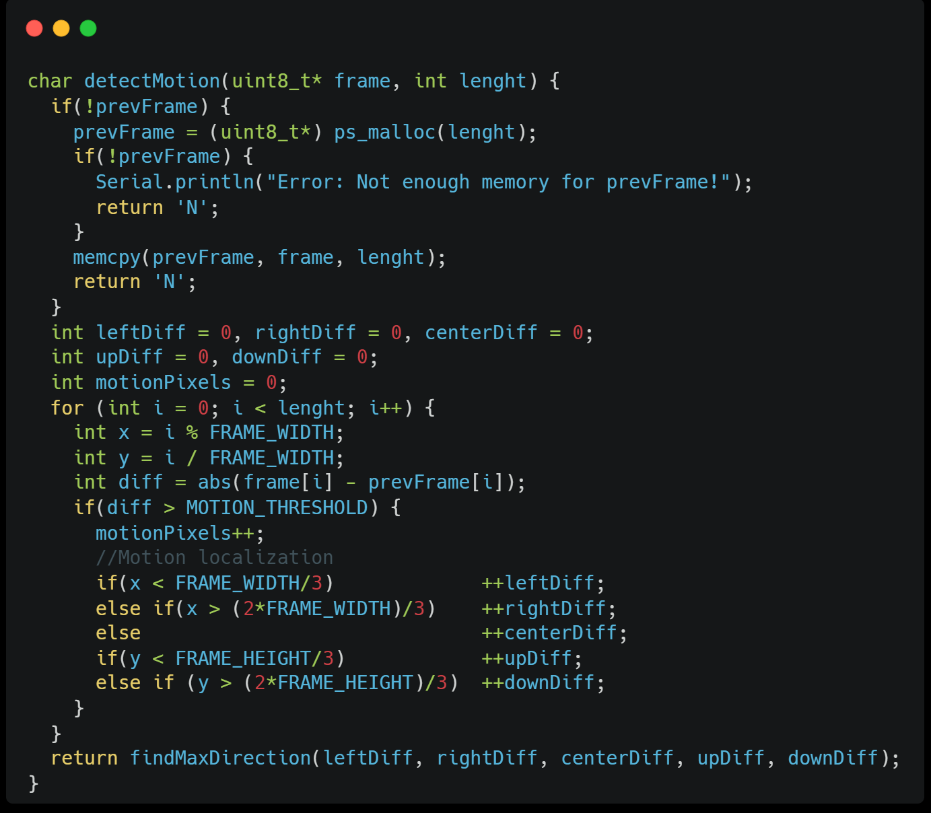
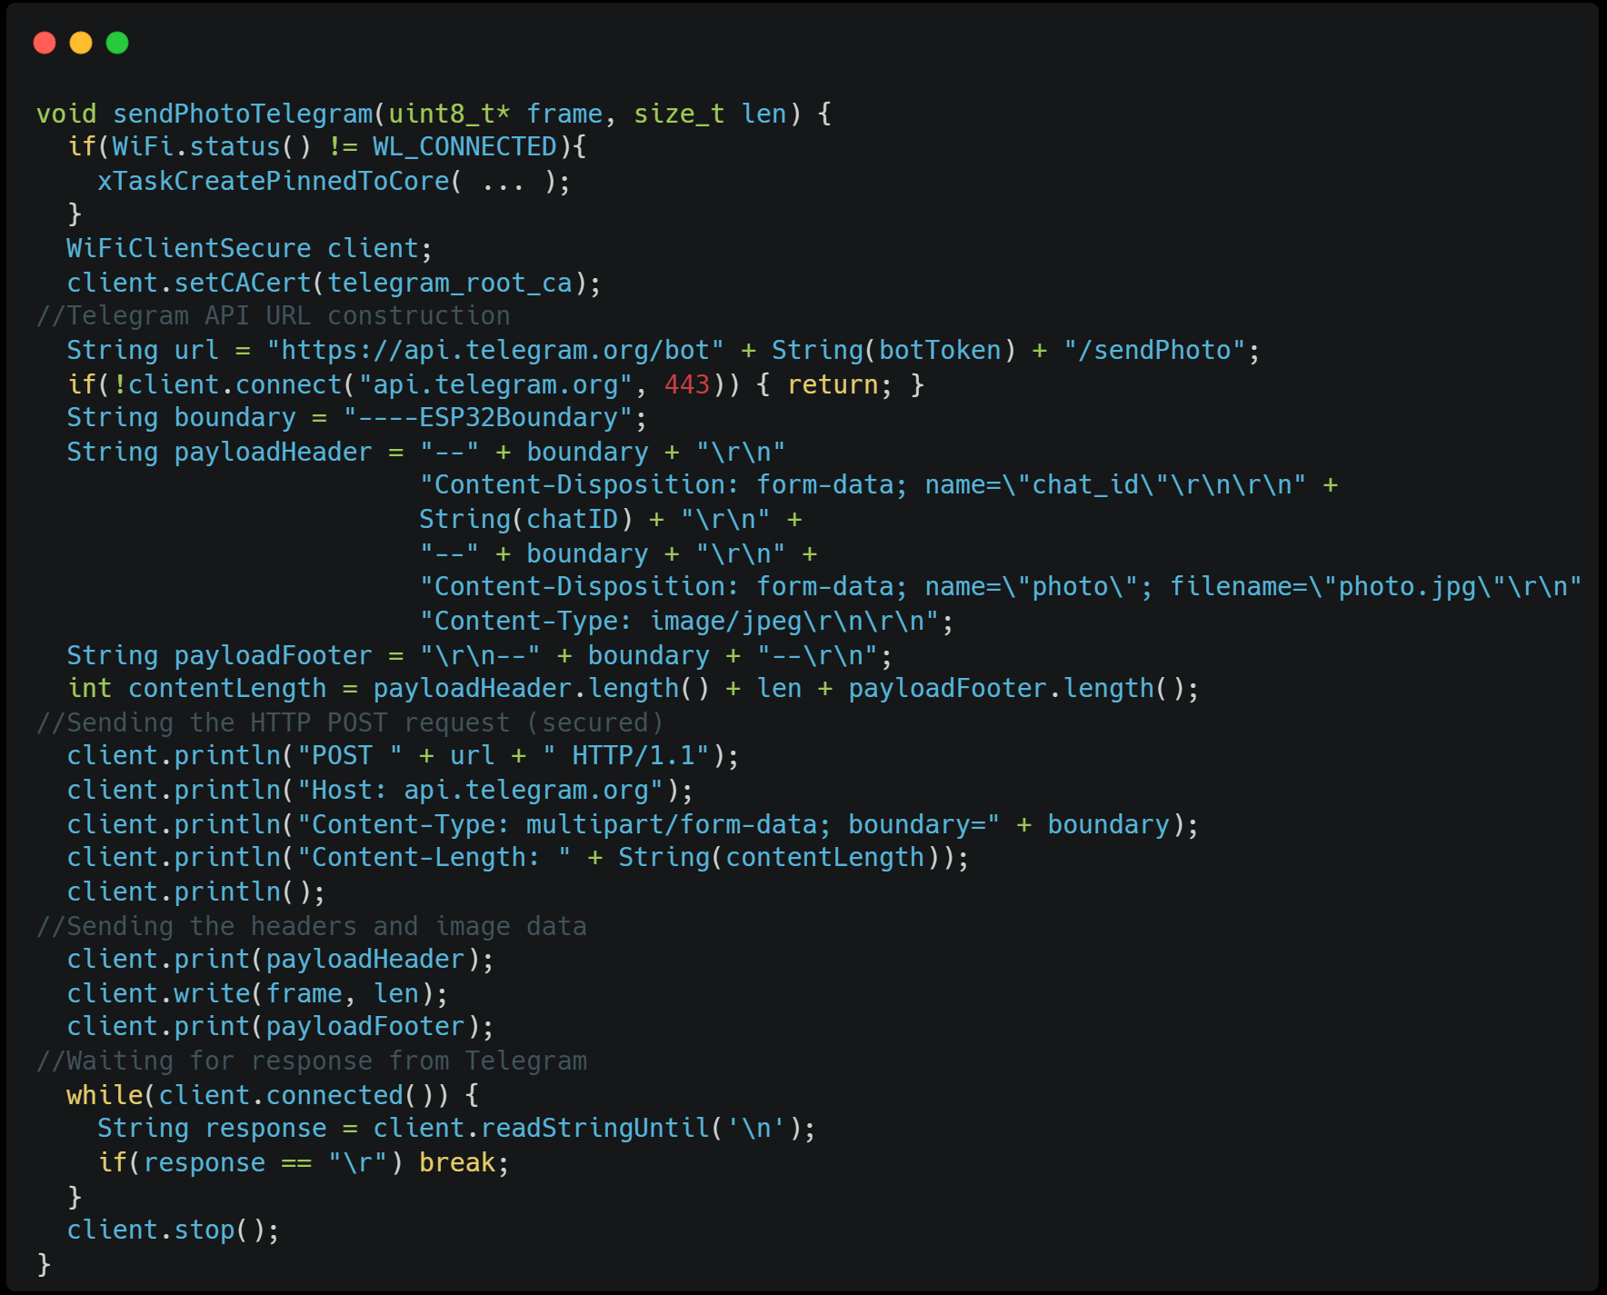
Smart Surveillance: Representative code blocks
MOTION DETECTION
SEND PHOTO TO TELEGRAM BOT

Slide 4
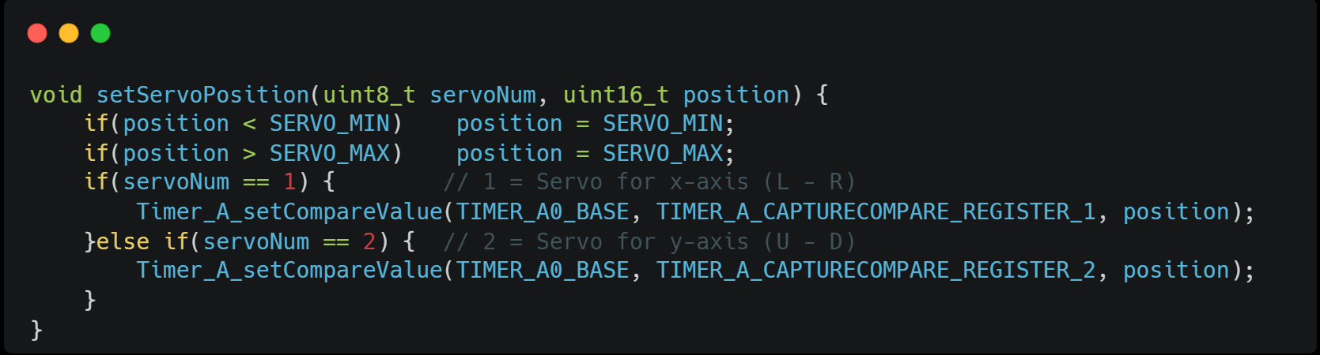
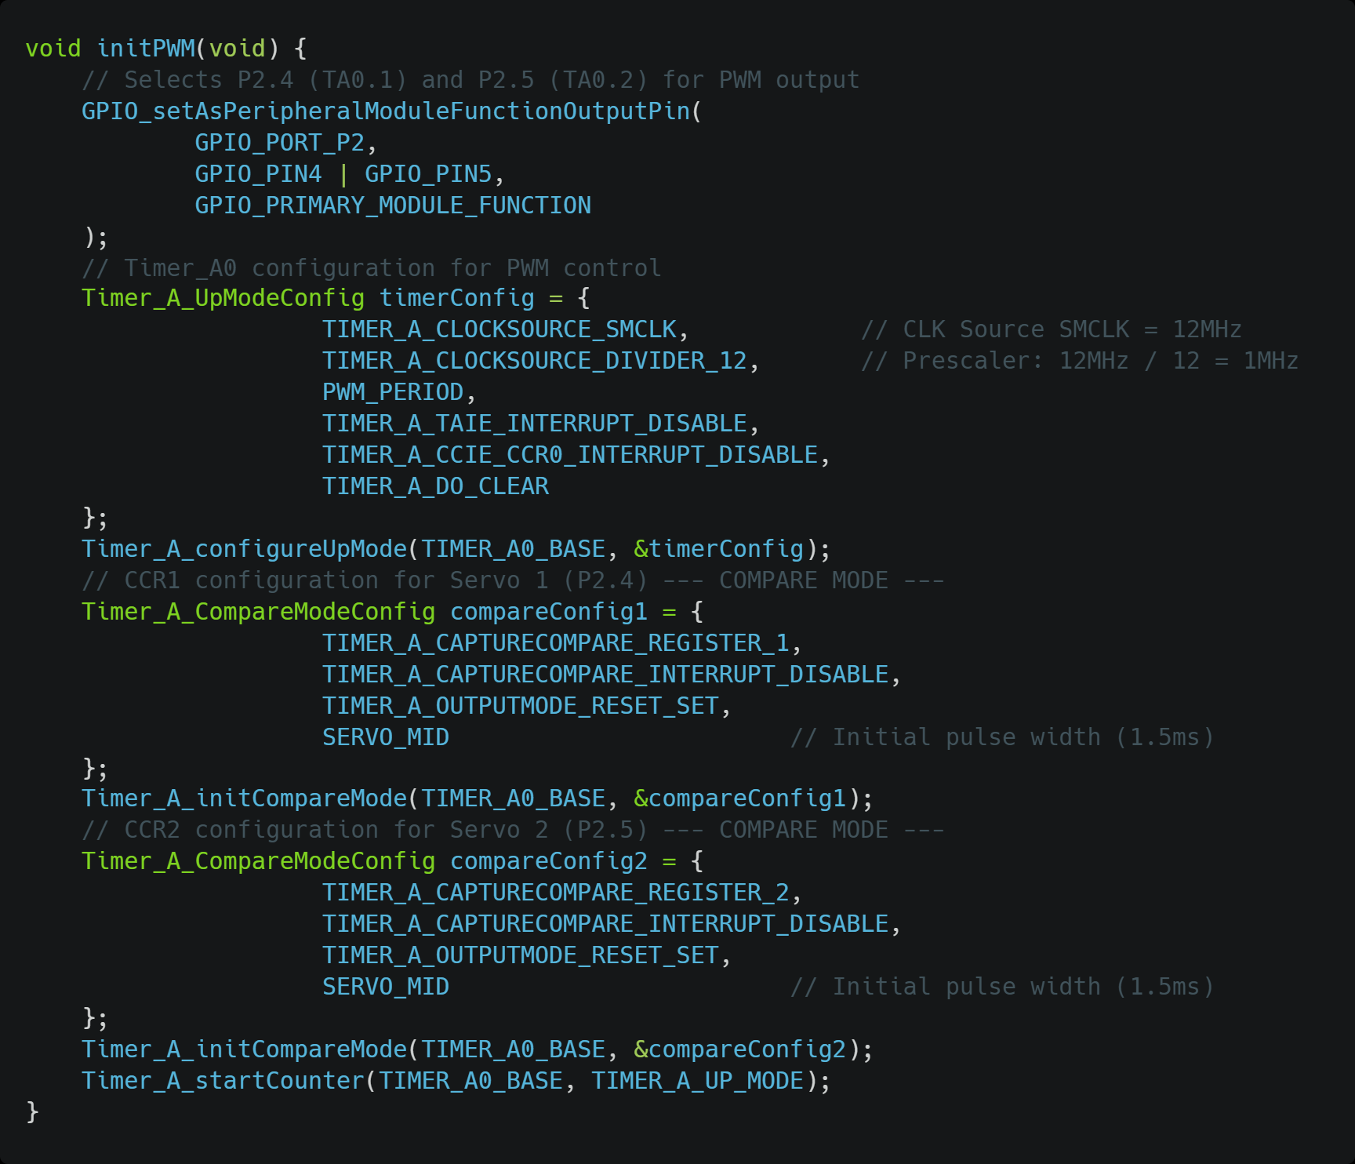
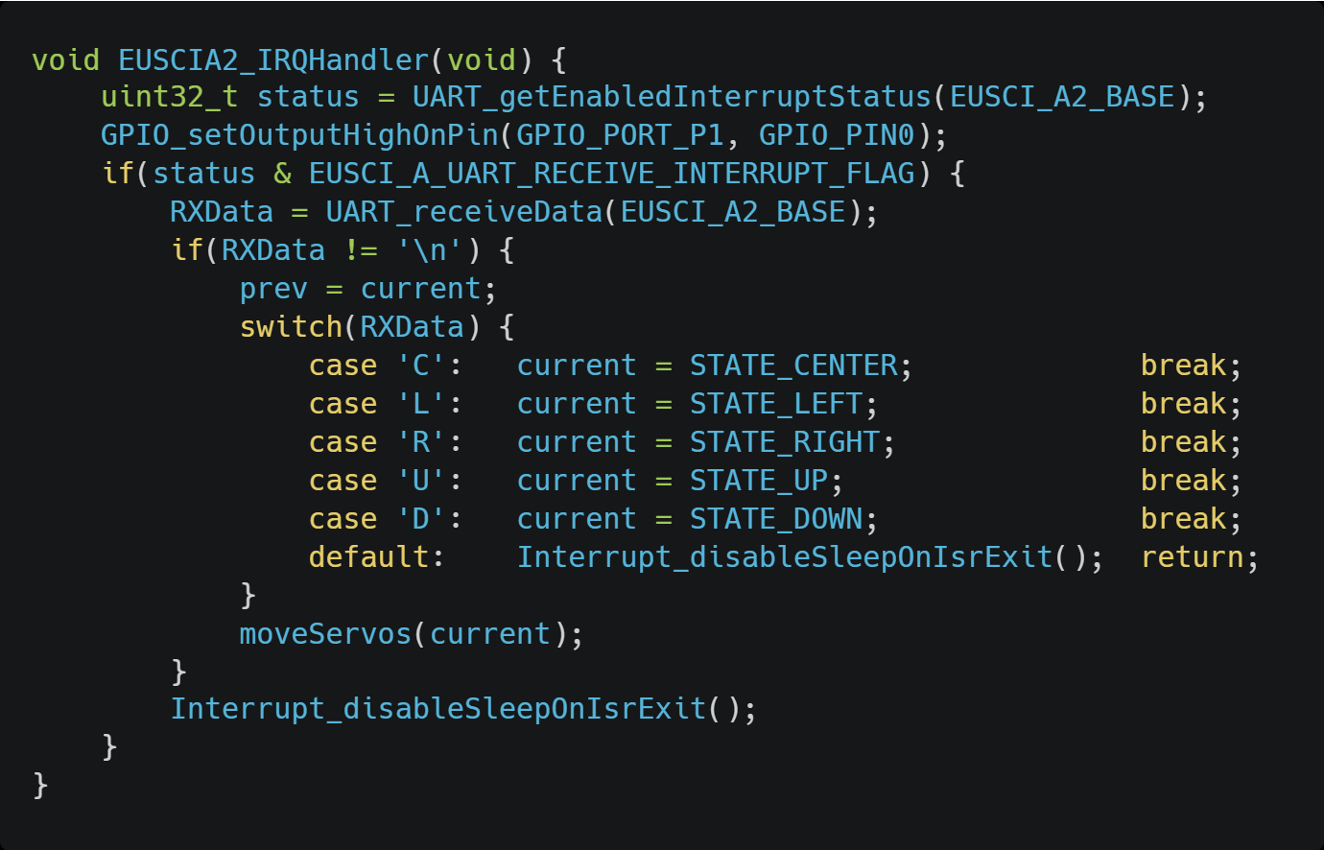
Smart Surveillance: Representative code blocks
PWM TIMER CONFIGURATION
INTERRUPT HANDLER

Slide 5

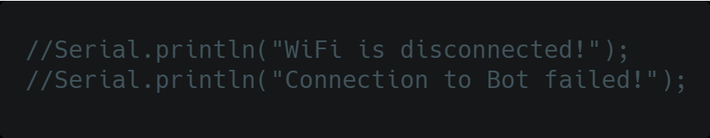

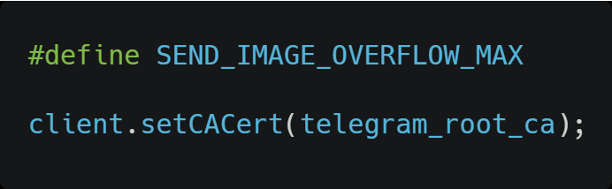
Smart Surveillance: Testing and Debugging
TESTING METHODOLOGY:
Code validation and debugging with serial monitor
Tested in an open area with sunny conditions with motion at ~2 meters distance
OBSTACLES/CHALLENGES ENCOUNTERED:
Efficient memory allocation → Moved prevFrame from DRAM to PSRAM
Secure HTTP communication and frame spam handling →
Motion localization during movement and UART communication → Added delays and flow controls
Frame computation structure and .JPG conversion → Grayscale instead of Compressed RGB
→ Telegram accepts only .PNG and .JPG

Slide 6

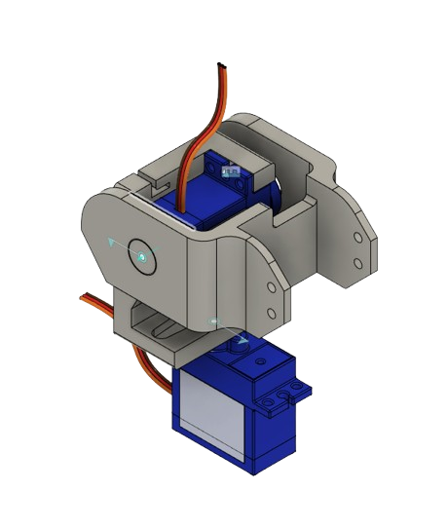

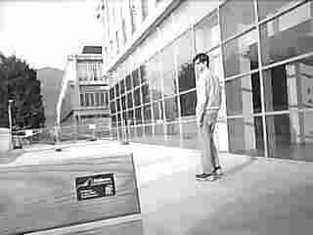
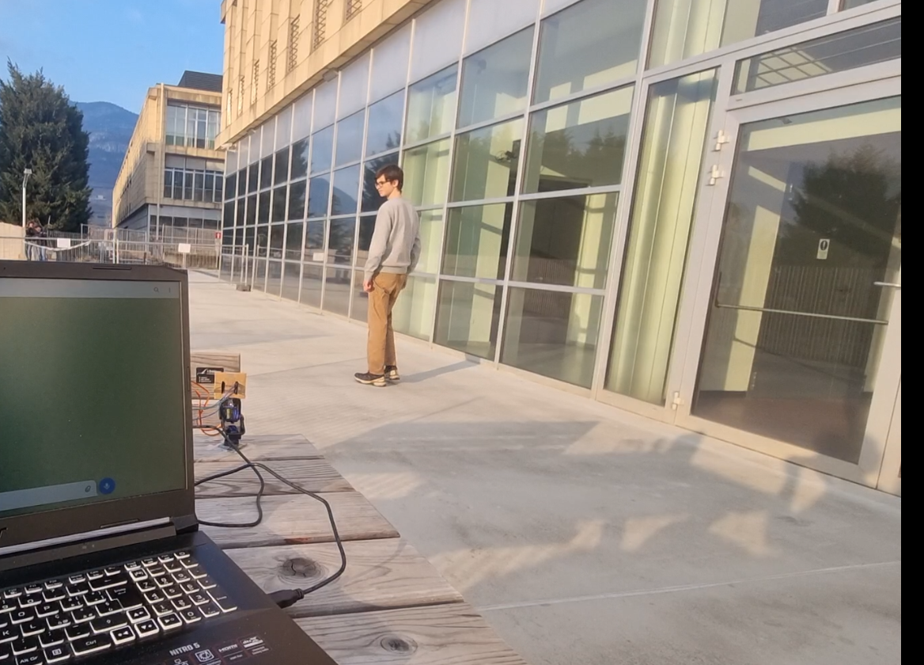

Smart Surveillance: Conclusions and Future Work
UPGRADE PROSPECTS:
Object recognition → Integrate YOLO algorithm for specific functionalities
Lightsource impact reduction → Implement automatic threshold calibration
Higher quality chassis → Improve detachable mounting for higher stability and accuracy
→ Select quality connectors to avoid noise or interferences
Enhanced user interaction → Add instantaneous full color snapshot command
→ Stream camera feed to dedicated website

Slide 7
Thank you for your kind attention and engagement!
The project was carried out for the course «Embedded Software for the IoT 2024/2025». All team members actively partecipated in pair programming throughout the project, working together to equally contribute to the development and refinement of the final result. We sincerely thank Assoc. Prof. K. S. Yildirim for the support and guidance!

